Slide 1
Fixed point representation
Presented By : Mr. Madhur Thapliyal
Assistant Professor
School of Computing
GEHU

Slide 2
Fixed Point Representation means that represents real numbers in a computer system, where the position of the decimal of the (or binary) point is fixed. This is in difference to floating point representation, where the position of the point can “float.” In fixed point representation, the number is split into an integer part and a fractional part.
Real numbers have a fractional component. In digital signal processing (DSP) and gaming applications, where performance is usually more important than precision, fixed point data encoding is extensively used
The Binary Point: Fractional values such as 26.5 are represented using the binary point concept. The decimal point in a decimal numeral system and a binary point are comparable. It serves as a divider between a number’s integer and fractional parts.
For instance, the weight of the coefficient 6 in the number 26.5 is 10⁰, or 1. The weight of the coefficient 5 is 10⁻¹ or (5/10 = 1/2 = 0.5).
2 * 10¹ + 6 * 10⁰ + 5 * 10⁻¹ = 26.5
2 * 10 + 6 * 1 + 0.5 = 26.5

Slide 3
A “binary point” can be created using our binary representation and the same decimal point concept. A binary point, like in the decimal system, represents the coefficient of the expression 20 = 1. The weight of each digit (or bit) to the left of the binary point is 20, 21, 22, and so forth. The binary point’s rightmost digits (or bits) have weights of 2-1, 2-2, 2-3, and so on.
For illustration, the number 11010.12 represents the value:
11010.1₂
= 1 * 2⁴ + 1 * 2³ + 0 * 2² + 1 * 2¹ + 0* 2⁰ + 1 * 2⁻¹
= 16 + 8 + 2 6.5
= 26.5

Slide 4
Two Types

Slide 5
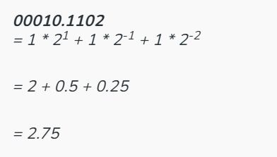
Unsigned Representation
For example, fixed<8,3> signifies an 8-bit fixed-point number, the rightmost 3 bits of which are fractional.
Representation of a real number:
00010.1102 = 1 * 2¹ + 1 * 2⁻¹ + 1 * 2⁻²
= 2 + 0.5 + 0.25
= 2.75

Slide 6
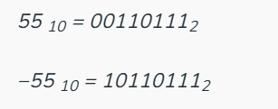
Signed Representation
Negative integers in binary number systems must be encoded using signed number representations. In mathematics, negative numbers are denoted by a minus sign (“-“) before them. In contrast, numbers are exclusively represented as bit sequences in computer hardware, with no additional symbols.
Signed binary numbers (+ve or -ve) can be represented in one of three ways:
Sign-Magnitude form
1’s complement form
2’s complement form
Sign-Magnitude form: In sign-magnitude form, the number’s sign is represented by the MSB (Most Significant Bit also called as Leftmost Bit), while its magnitude is shown by the remaining bits (In the case of 8-bit representation Leftmost bit is the sign bit and remaining bits are magnitude bit).

Slide 7
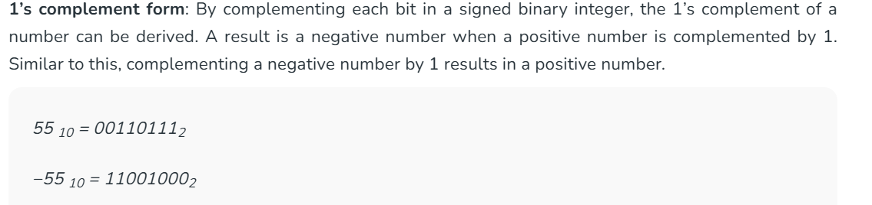
1’s Compliment
1’s complement form: By complementing each bit in a signed binary integer, the 1’s complement of a number can be derived. A result is a negative number when a positive number is complemented by 1. Similar to this, complementing a negative number by 1 results in a positive number.

Slide 8
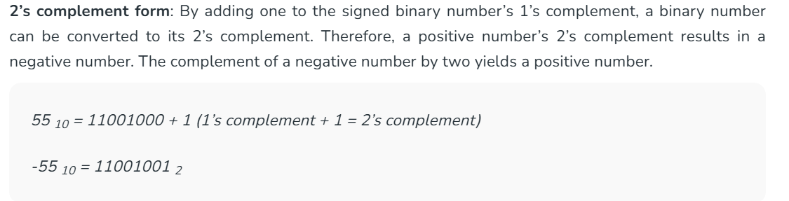
2’s Compliment

Slide 9
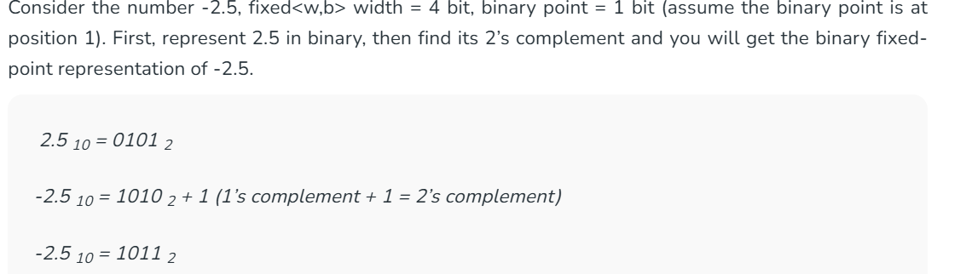
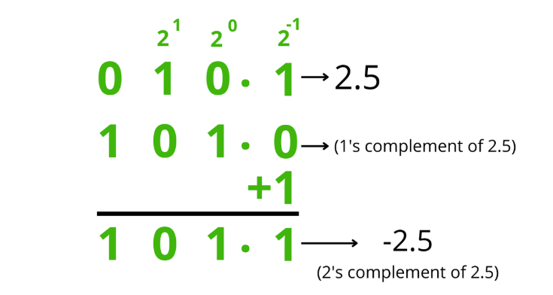
Fixed point representation of Negative Number

Slide 10
Vector Representation
The representation of vector is done by a directed line segment. It is an arrow that has a head and a tail. here,
The starting point of the vector is called its tail (or) the initial point of the vector.
The ending point of the vector is called its head (or) the terminal point of the vector.
The head of the vector shows its direction. The direction of the vector is the angle made by it with a reference line. A vector that starts from a point A and ends at a point B is denoted by −−→ABAB→.

Slide 11
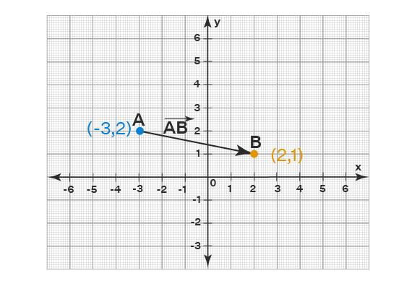

Slide 12
The above vector can also be represented by - −−→BABA→ which is the negative of the vector −−→ABAB→.
Sometimes vectors are denoted by a single small letter also with an arrow over it. For example, we can label the above vector −−→ABAB→ as →aa→. But we cannot identify the initial point and the final point of the vector in this representation though.

Slide 13
Representation of Position vectors
The points on a coordinate plane is represented by position vectors. In the above figure,
The point A is represented by the position vector −−→OAOA→ = <-3, 2>
The point B is represented by the position vector −−→OBOB→ = <2, 1>
Here, O is the origin. We can calculate the components of a vector −−→ABAB→ by subtracting the position vector of initial point from that of the terminal point. In the above figure,
−−→ABAB→ = −−→OBOB→ - −−→OAOA→
= <2, 1> - <-3, 2>
= <2 -(-3), 1 - 2>
= <5, -1>
Thus, the vector that represents −−→ABAB→ in the above figure is <5, -1>.

Slide 14
Representation of vector magnitude
The magnitude of a vector −−→ABAB→ is represented by either |−−→ABAB→| or simply AB. We use AB to represent the magnitude of the vector −−→ABAB→ because the magnitude is nothing but its length and AB represents the length of the line segment connecting A and B. In the same way, the magnitude of a vector →aa→ is represented as either |→aa→| or simply 'a'. We can find the magnitude of a vector (when we know its components) by taking the square root of the sum of the squares of the components. From the last example,
−−→ABAB→ = <5, -1>
Its magnitude is,
|−−→ABAB→| (or) AB =√(5)² + (-1)² = √26

Slide 15
Representation of vector Operations
For any three vectors →aa→, →bb→, and →cc→:
→aa→ + →bb→ represents the sum of vectors.
→aa→ - →bb→ represents the difference of vectors.
→aa→ · →bb→ represents the dot product of vectors.
→aa→ × →bb→ represents the cross product of vectors.
ˆaa^ represents the unit vector in the direction of →aa→.

